Slide 1
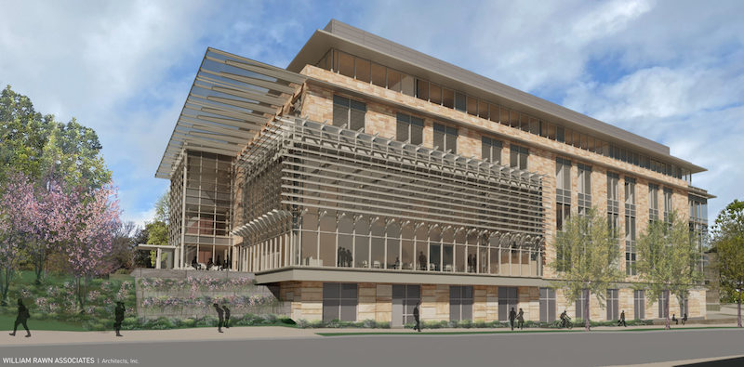
WEEK 3: USER EXPERIENCE + DESIGN

Slide 2
WEEK 3 OVERVIEW
This week connects human-centered design with the ways people notice, remember, and interact with digital marketing. The lessons apply those ideas to websites, landing pages, ads, and mobile experiences.

Slide 3
WEEK 3 ROADMAP
SECTION 1: DESIGNING FOR PEOPLE
SECTION 2: LAWS OF UX
SECTION 3: DESIGN PRINCIPLES
SECTION 4: A PAGE TEMPLATE
SECTION 5: MOBILE INTERACTION

Slide 4
SECTION 1: DESIGNING FOR PEOPLE
Design begins with the people who will use the experience.

Slide 5
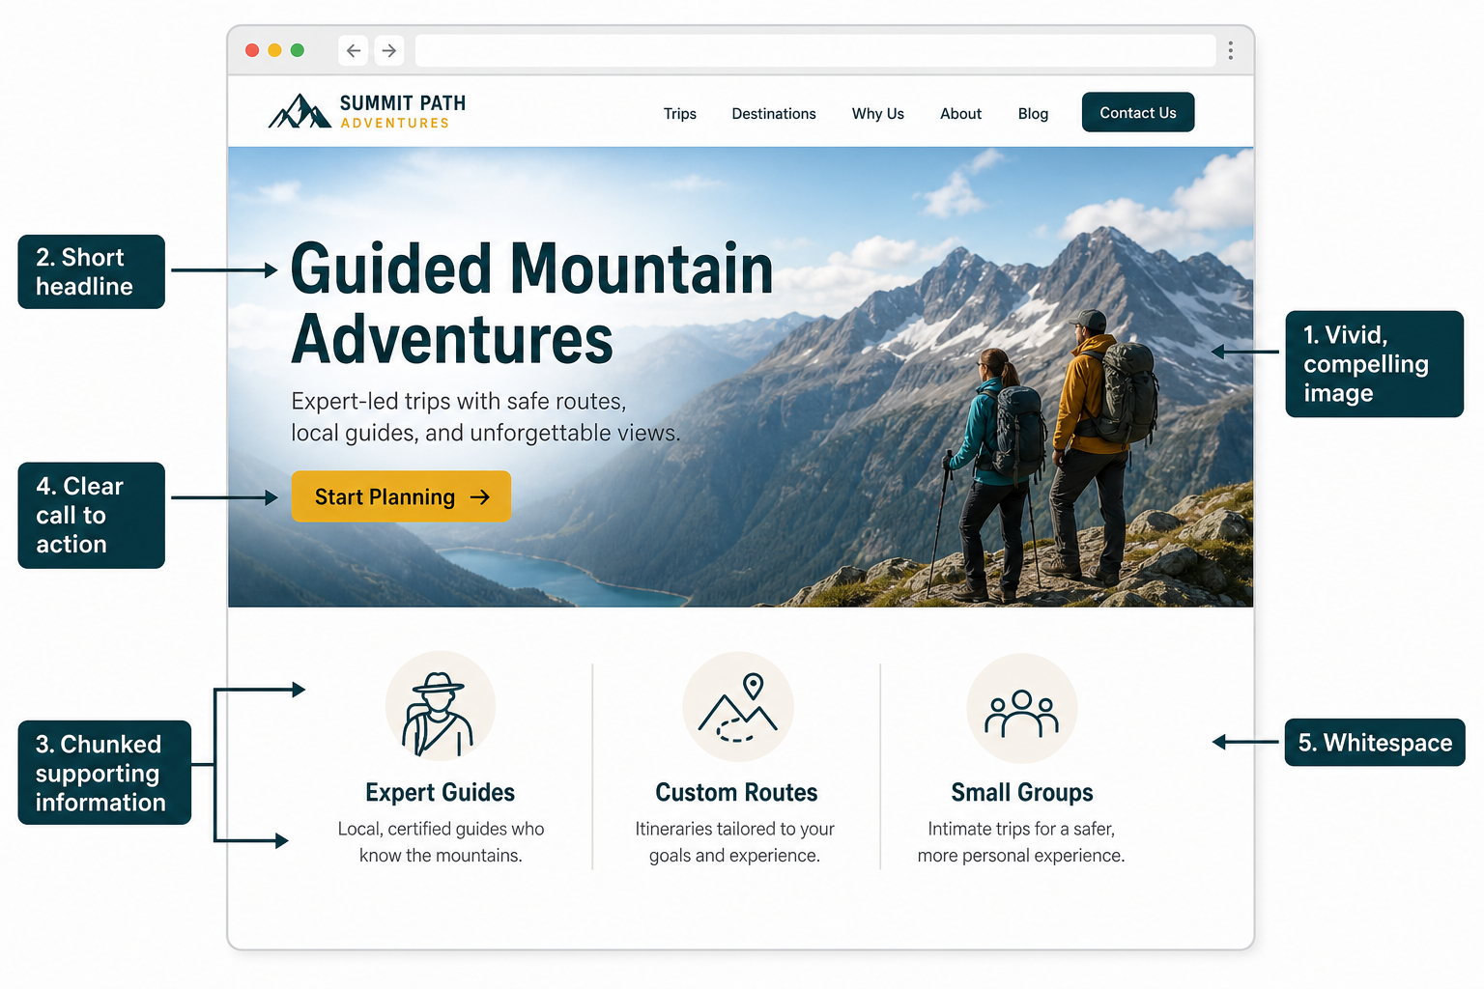
UX AND UI
User experience describes how the whole interaction works and feels. User interface describes the visible controls and elements people use. Digital marketing needs both: a clear message and an interface that makes the next step easy.

Slide 6
HUMAN-CENTERED DESIGN
Human-centered design starts with the audience’s needs, behaviors, abilities, and context.
• Learn from the people who will use the material.
• Design around their goals and limitations.
• Test whether the experience works as intended.

Slide 7
SHORT-TERM MEMORY
Working memory holds only a limited amount of information at once. Dense pages, unclear choices, and unfamiliar controls increase mental effort. Digital marketing should make the most important information easy to notice and process.

Slide 8
SECTION 2: LAWS OF UX
Design choices can reduce cognitive load and support familiar behavior.

Slide 9
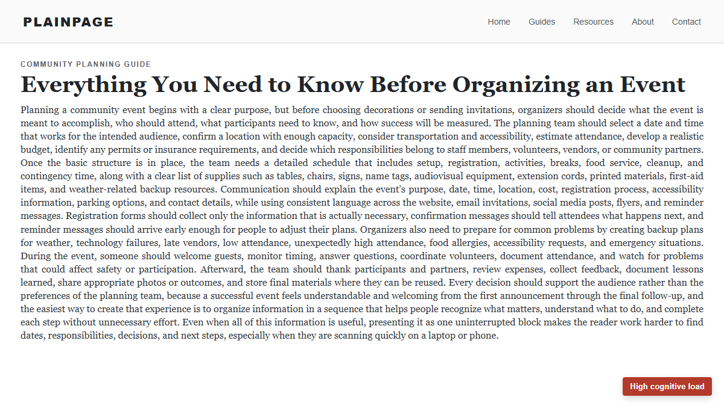
WALL OF TEXT
A large, uninterrupted paragraph makes readers work harder to find what matters. Reduce cognitive load by shortening, grouping, and labeling related information.

Slide 10
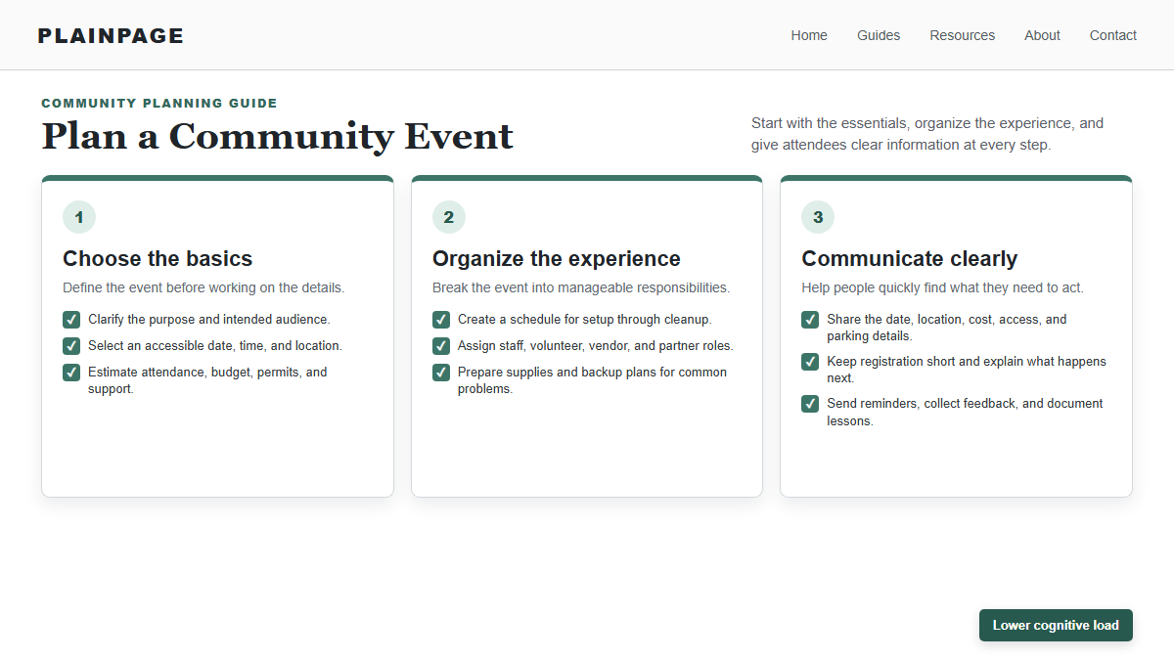
CHUNKING
Chunking groups related information into clear sections. Headings, spacing, scale, and dividers help users scan the page and understand how ideas relate.

Slide 11
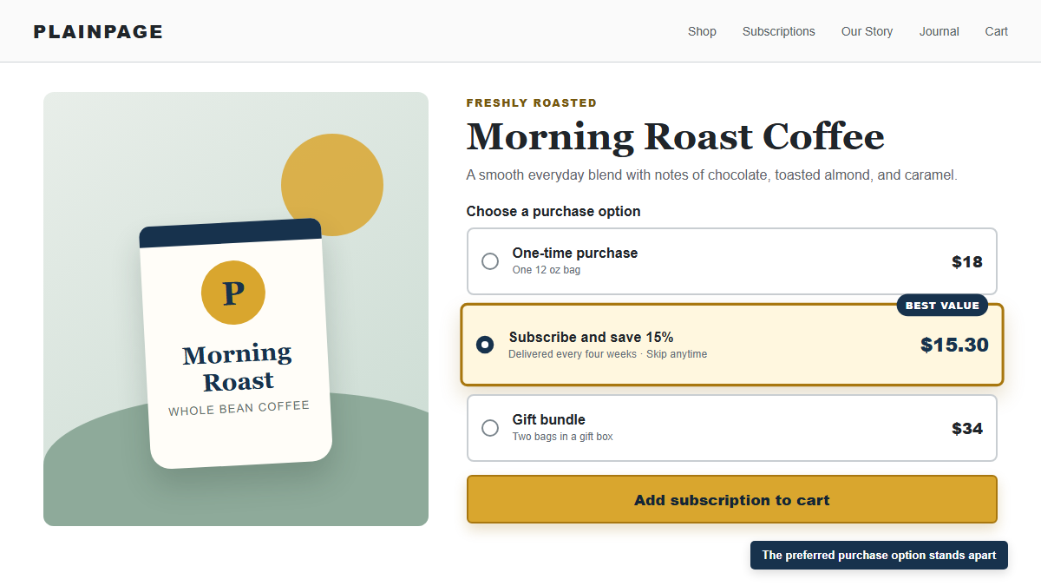
CHOICE AND DISTINCTION
Hick’s Law explains why more complex choices take longer. The Von Restorff Effect predicts that the item that differs from similar items is more likely to be remembered. Highlight the recommended action without adding unnecessary choices.

Slide 12
SECTION 3: DESIGN PRINCIPLES
Visual structure tells people what belongs together and what matters most.

Slide 13

ALIGNMENT AND PROXIMITY
Alignment creates order and connection. Proximity groups related items so users can understand the page more quickly.

Slide 14

HIERARCHY
Hierarchy gives more visual weight to the most important message. Contrast makes that difference visible through size, weight, color, or placement.

Slide 15

SPACE + COLOR
White space gives elements room to breathe and helps direct attention. Color can emphasize actions and reinforce a brand, but text and backgrounds need sufficient contrast for readability.

Slide 16
SECTION 4: A PAGE TEMPLATE
A focused homepage answers the user’s main questions above the fold.

Slide 17
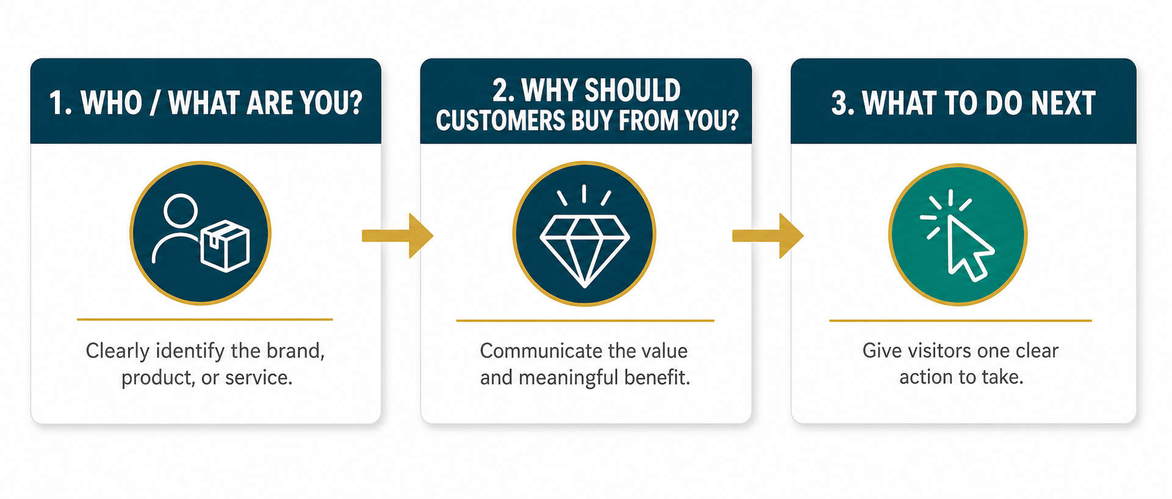
THE THREE QUESTIONS
A homepage or landing page should quickly answer:
1. Who or what are you?
2. Why should customers buy from you?
3. What should they do next?

Slide 18
PAGE TEMPLATE
Use a vivid image, a short headline, concise supporting information, and a clear call to action. Chunk any extra details and leave enough white space for the page to remain readable.

Slide 19
SECTION 5: MOBILE INTERACTION
Mobile design accounts for changing grips, thumb reach, and attention at the center of the screen.

Slide 20
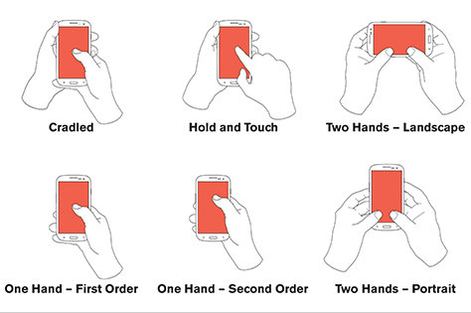
MOBILE GRIP PATTERNS
People hold phones in several ways and frequently shift their grip. Mobile experiences should not depend on one assumed hand position.

Slide 21
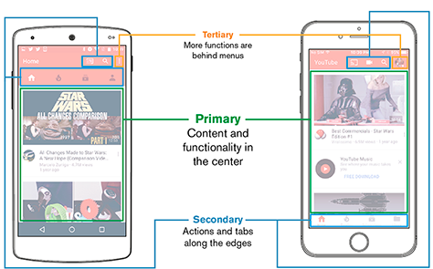
TOUCH-FRIENDLY DESIGN
People read and tap most accurately near the center of the screen. Place primary content in the center, secondary actions along the edges, and less important functions behind menus.

Slide 22
KEY TAKEAWAYS
User experience includes the full interaction. User interface includes the visible controls.
• Human-centered design begins with the audience.
• Design around real needs, behaviors, abilities, and context.

Slide 23
KEY TAKEAWAYS
Short-term memory is limited, so digital content must reduce unnecessary cognitive load.
• Break dense information into related chunks.
• Limit choices and make the recommended action distinctive.

Slide 24
KEY TAKEAWAYS
People expect websites to use familiar patterns and controls.
• Alignment and proximity create order and relationships.
• Hierarchy, contrast, space, repetition, and color guide attention.

Slide 25
KEY TAKEAWAYS
A focused homepage answers who you are, why customers should buy, and what they should do next.
• Keep the headline and supporting information concise.
• Use one clear call to action and enough white space.

Slide 26
KEY TAKEAWAYS
Mobile users change grips and interact most accurately near the center of the screen.
• Keep primary content central.
• Place secondary actions along the top and bottom edges.

